Slide 1
Project Update 2
Alec Schneider

Slide 2
Overall Summary
Accomplishments This Past Period:
Finalized logic for NA values in columns
Explored distributions of variables
Explored the relationships between variables
Mapped all flight patterns in the data
Created GitHub repository for version control
Created business questions and identified variables that may be used in answering them
Began exploratory data analysis
Created a chart of the Satisfaction variable to visualize the distribution of the scores
Explored NA values in each columns
Next Steps:
What’s working well:
Sole creative vision
Note taking and comments within the code are detailed and informative
Issues:
Individual work is leading to lack of constructive feedback on ideas

Slide 3
Business Questions
Which airlines and origin cities have the highest rates of departure delays and cancellations?
Variables: Airline Code, Airline Name, Origin City, Flight Cancelled, Departure Delay in Minutes
Do vacation destinations have a higher satisfaction?
Variables: Satisfaction, Type of Travel, Destination City
Which demographics are most price sensitive?
Variables: Age, Gender, Price Sensitivity
Which airlines have the highest satisfaction scores? Distribution of the scores should be factored in as well.
Variables: Satisfaction, Airline Code, Airline Name
Which variables affect Satisfaction most?
Variables: Type of Travel, Flight Cancelled, Departure Delay in Minutes, Arrival Delay in Minutes, Flight Time in Minutes, Flight Distance, Arrival Delay Greater 5 Mins, Airline Code, Shopping Amount at Airport, Eating and Drinking at Airport, Class, Airline Status, Age, Gender, Price Sensitivity, No of Flights P.A., % of Flight With Other Airlines, No. of Flight With Other Airlines

Slide 4
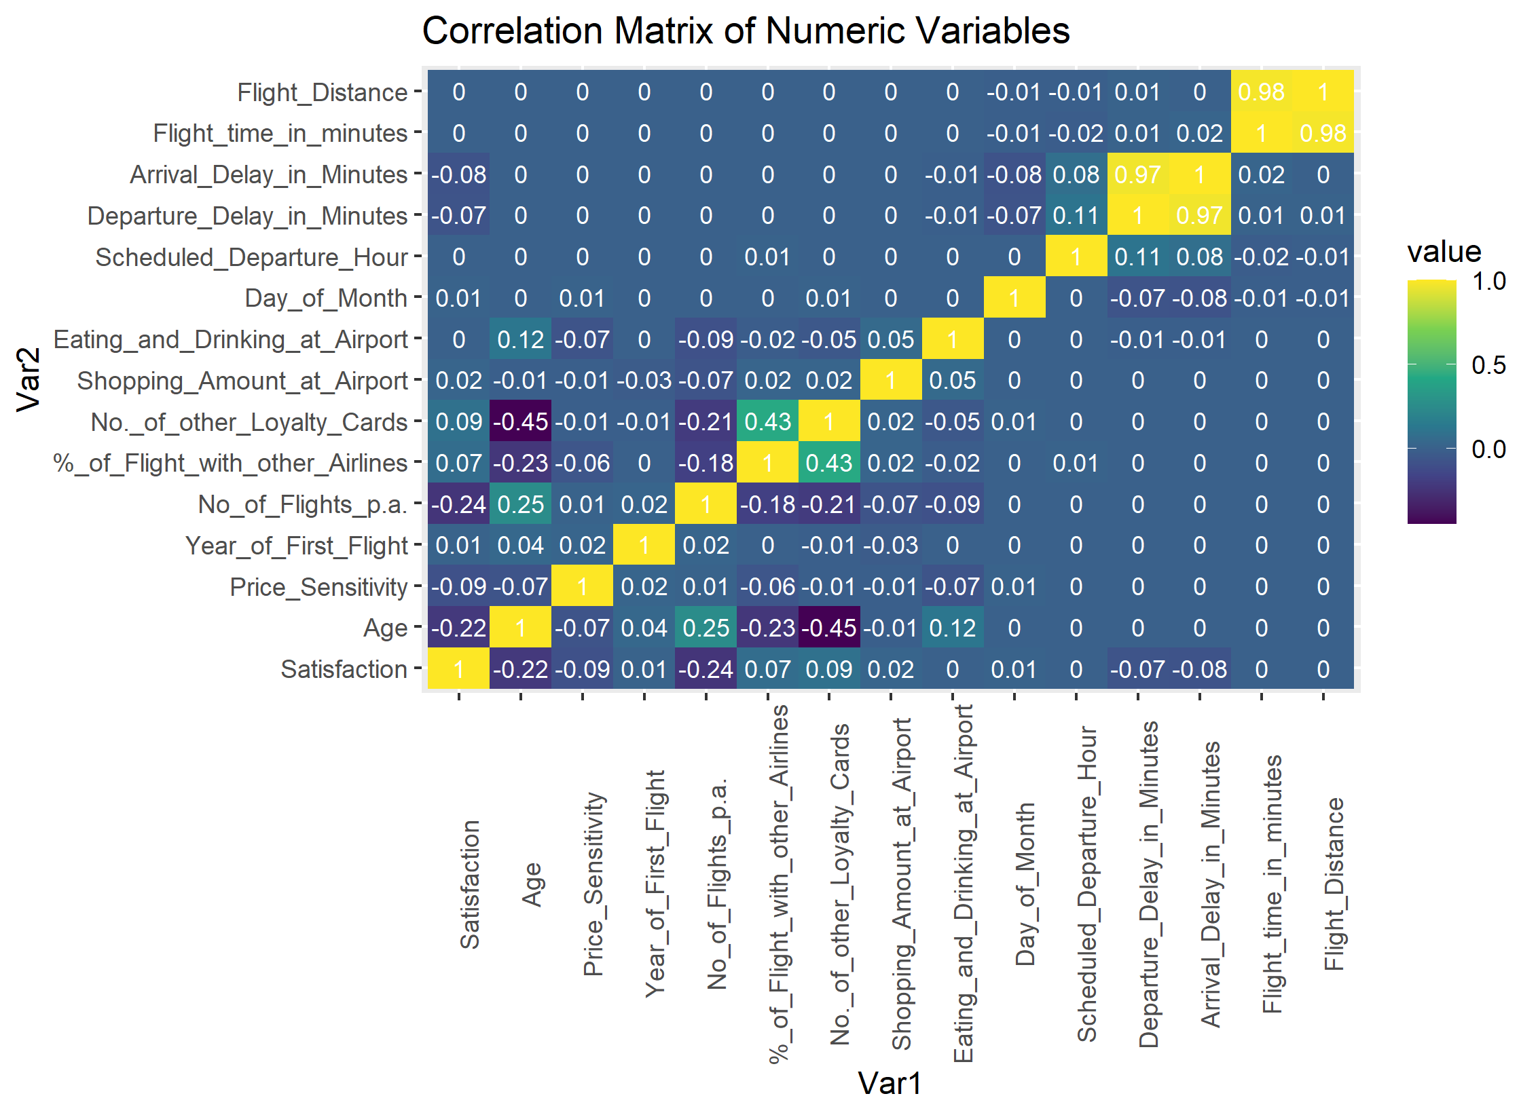
Relationships Between Variables
No strong correlations with our y variable, Satisfaction

Slide 5
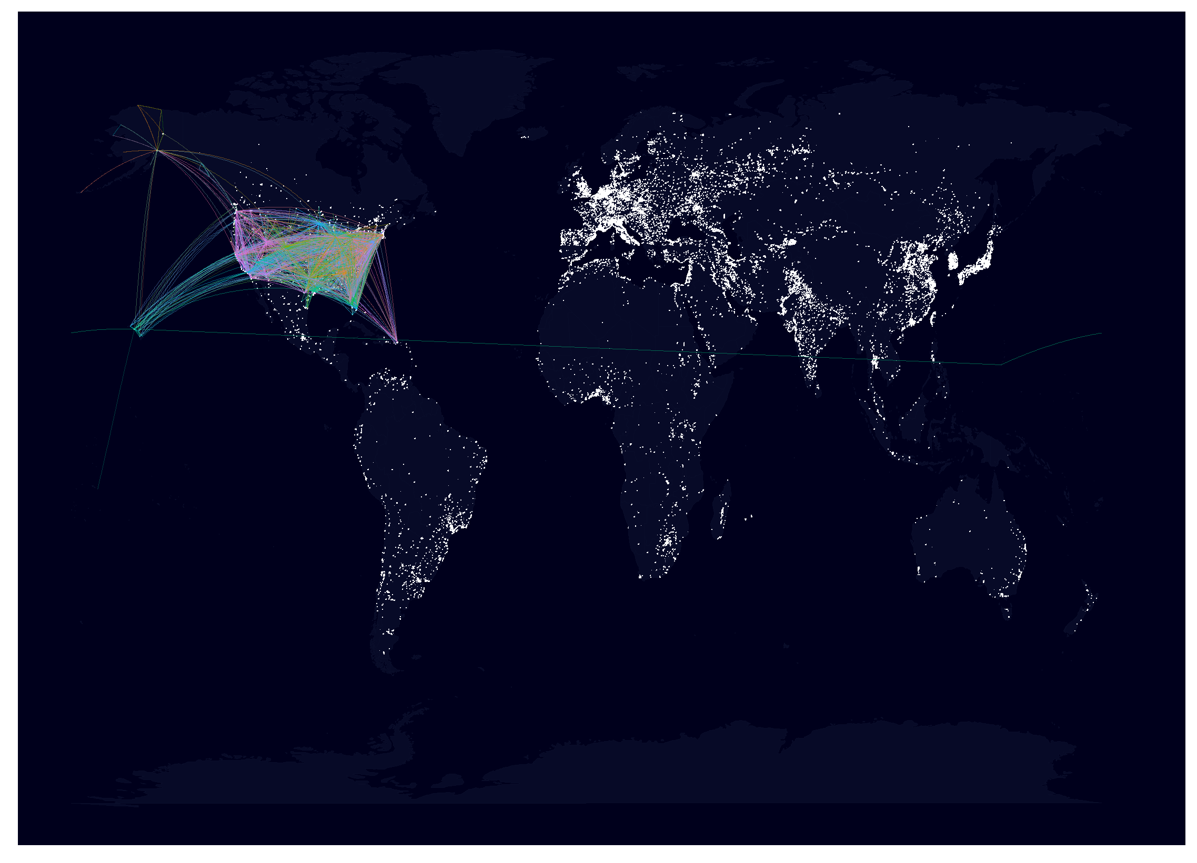
Map of Flight Routes
U.S. View
World View

